Slide 1

Student Management System
Project Coordinator Amruta Deore Represented By:
Dipali Sampat Wale
dipawale6@gmail.com

Slide 2
Software Requirements
1. Operating System - Windows 10.
2. Platform - Eclipse IDE.
3. Language - Core java.
4. Files - JDK 16.0.2

Slide 3
Introduction
This project “Student Management System” provides us a simple interface for maintainance of student information.It can be used by educational institutes or colleges to maintain the records of students easily.
We have to used different types of module in student management system.
Throughout the project the focus has been on presenting information in an easy and intelligible manner.
The project provides facilities like online registration and profile creation of students thus reducing paperwork and automating the record generation process in an educational institution.

Slide 4
Modulels
There are four modules used in this project
Login
Registration
Student
TestStudent

Slide 5
1) Login
Method:
Void log();
Create scanner class object.
print the message enter user name, password.
print the variable with scanner class object.

Slide 6
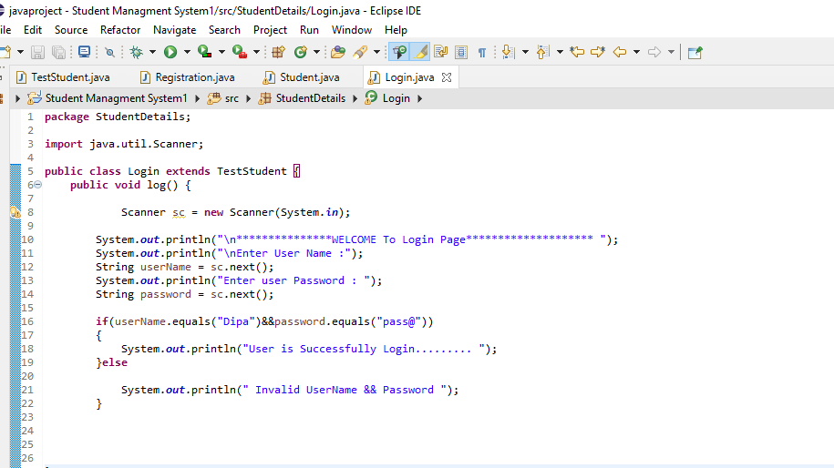

Slide 8
2) Registration
Using Inheritance and Encapsulation
Inheritance:
Encapsulation:
1)Getter Method()
2)Setter Method()
3)toString()

Slide 9
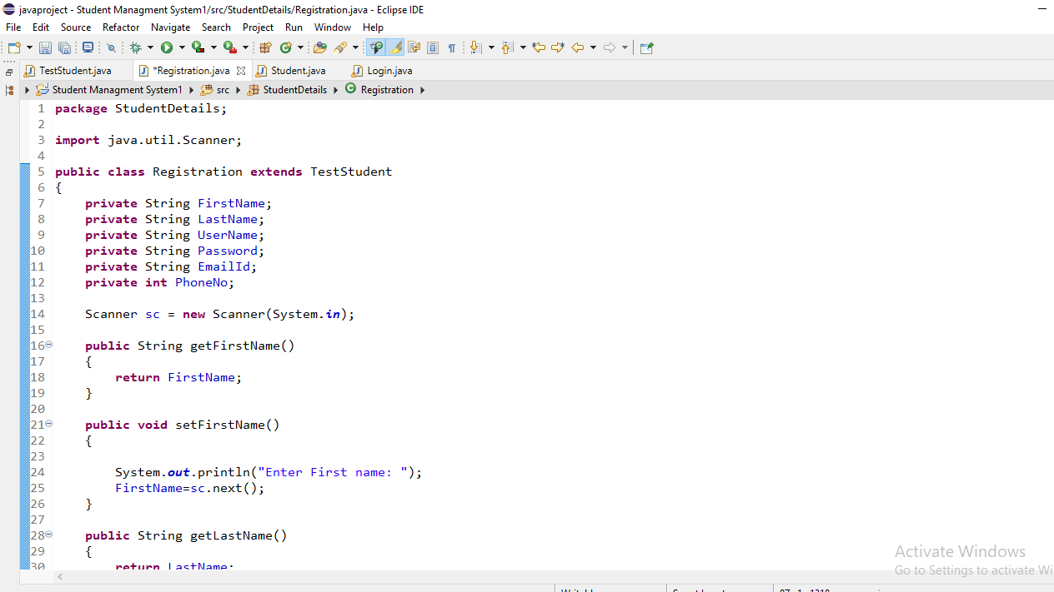

Slide 10
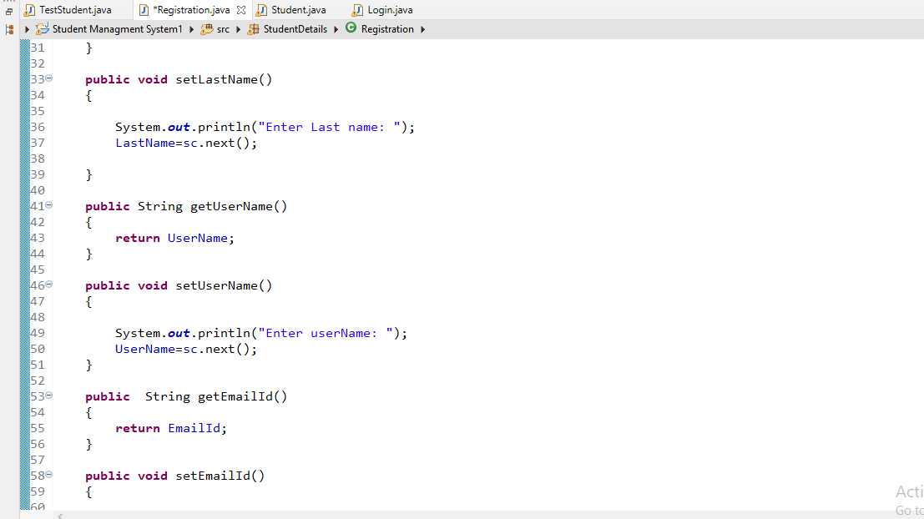

Slide 11
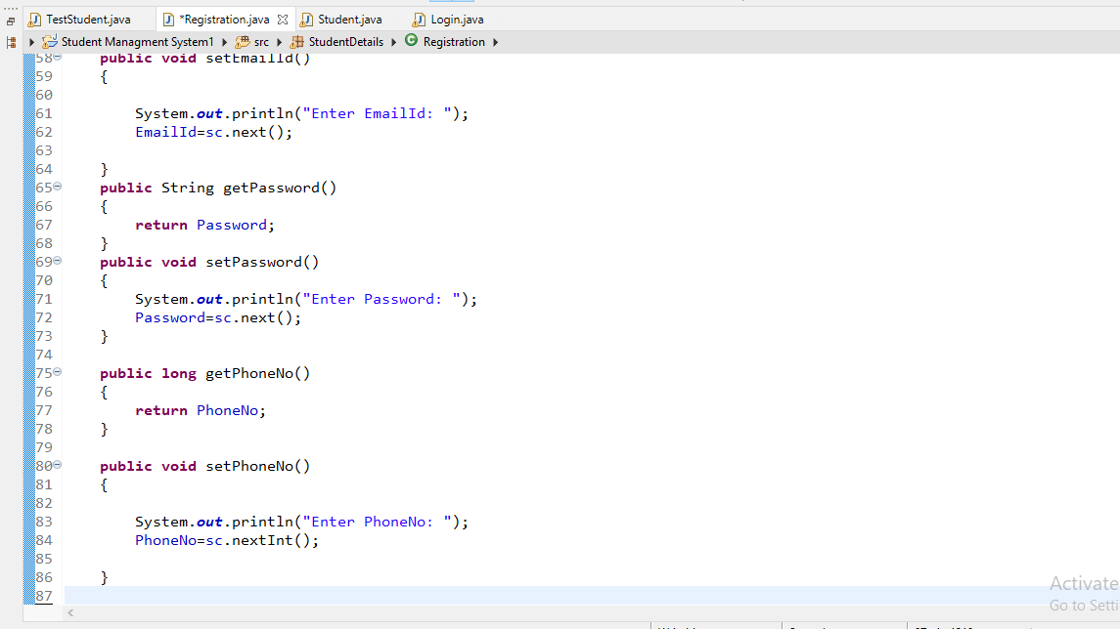

Slide 12
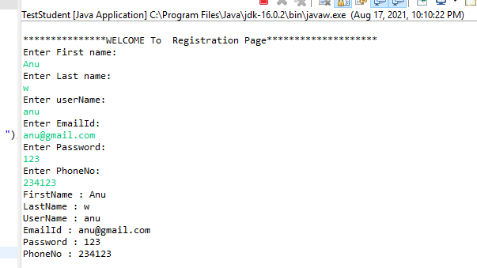

Slide 13
3) Student
Declaring variables:
private String First Name;
Private String Last Name;
private String Email ID;
private int PhoneNo;
private String Address;
private int Year;
private String Courses=" ";
private int Balance;
Private int Student ID;
private static int CostOfCourse=600;

Slide 14
3) Student
Using Constructor
Public student()
It is used for object initialization and printing.
Method:
1)Void course()
In that method we have to initialize int i; variable and print the how many course enroll and year of student.

Slide 15
2) void viewBalance()
For Printing
System.out.println(“\nYour Balance is :$” + Balance);
3) void payTution()
viewBalance();
System.out.print("\nEnter Your Payment: $");
int payment = sc.nextInt();
Balance =Balance - payment;
System.out.println("\nThank you for your payment of $" + payment);

Slide 16
3) toString()
It is used for return the value of the object .
toString();
return "\nName: "+ FirstName + " " + LastName +
"\nAddress: " + Address +
"\nStudent ID: " + StudentID +
"\nPhoneNo: " + PhoneNo +
"\nEmail Id: " + EmailId +
"\nCourses Enrolled: " + Courses +
"\nBalance: $ " + Balance;

Slide 17
Loop:
1)Do while :
A do while loop is a control flow statement that executes
a block of code at least once, and then repeatedly execute
the block.
2)If:
Use the if statement to specify a block of Java code to
executed if a condition is true.
3)else:
Use the else statement to specify a block of code to be
executed if the condition is false.

Slide 18
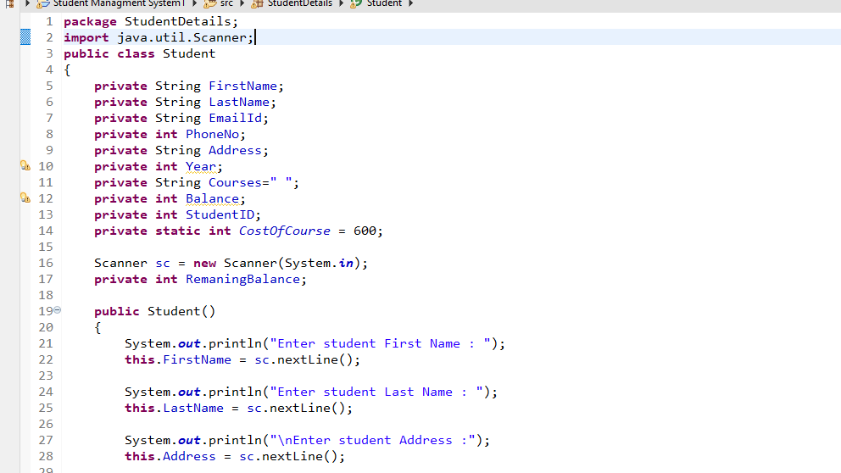
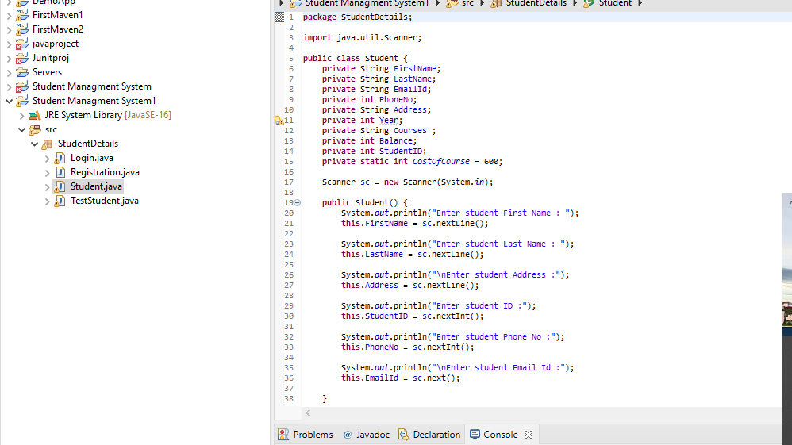

Slide 19
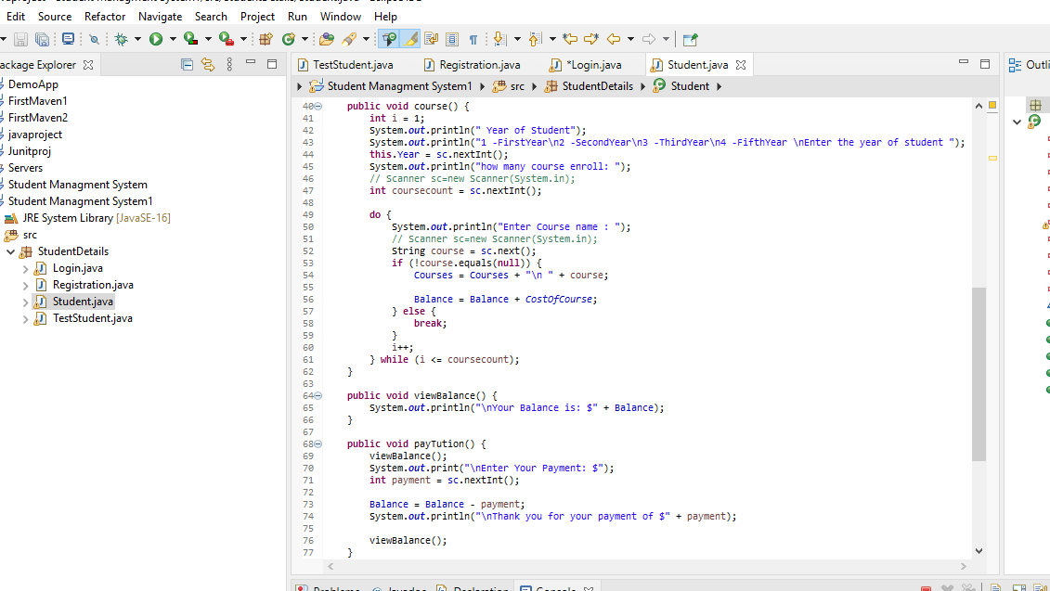
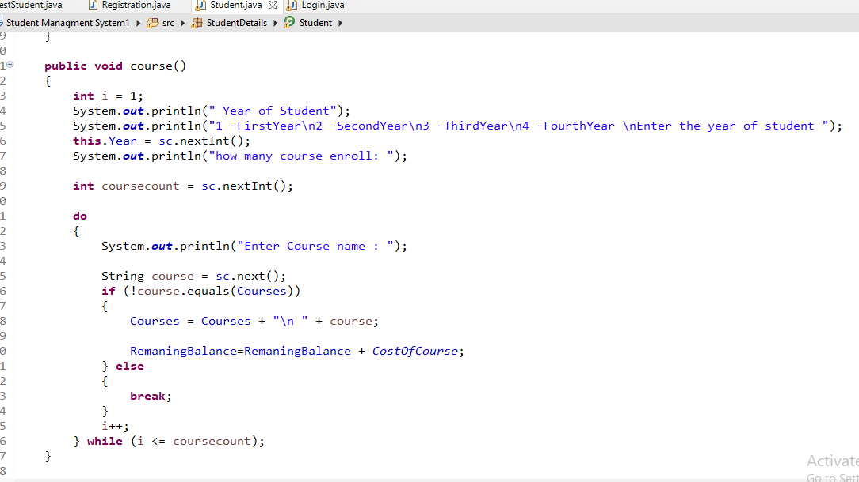

Slide 20
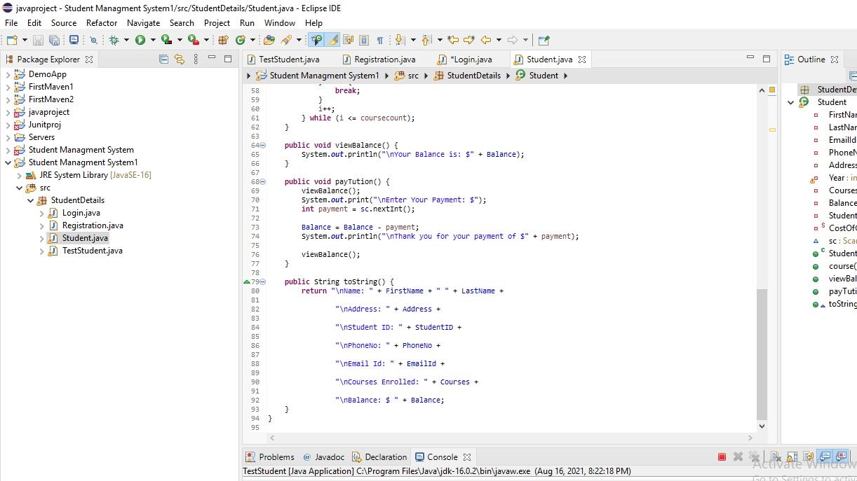
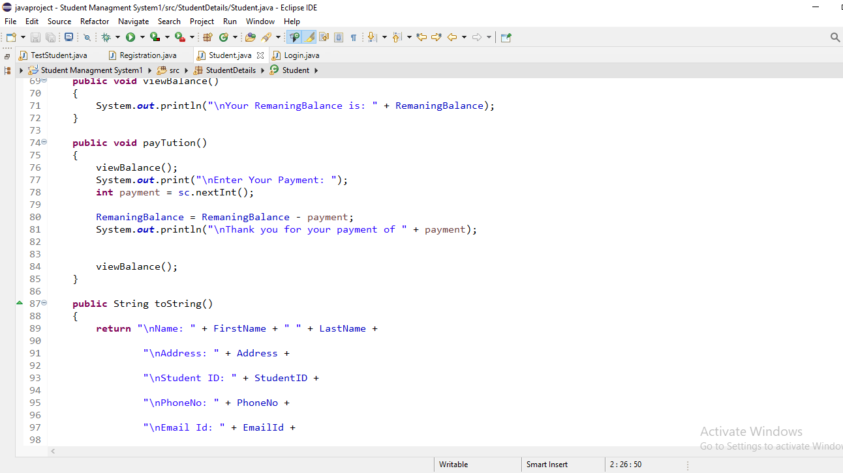

Slide 21
4) TestStudent
All class object creation and call the all method here.
Scanner sc=new Scanner(System .in);
1)Login l=new Login ();
l.log();
2) Registration reg =new Registration();
reg.setmethod();
reg.getmethod(); {through Encapsulation}

Slide 22
3) Student stud=new Student();
System.out.println("Enter Number Of New Student To Enroll:");
int numOfStudents=sc.nextInt();
Student[] students=new Student[numOfStudents];
for(int n=0; n<numOfStudents; n++){
students[n]=new Student();
students[n].course();
students[n].payTution();
System.out.println(students[n].toString());
}

Slide 23
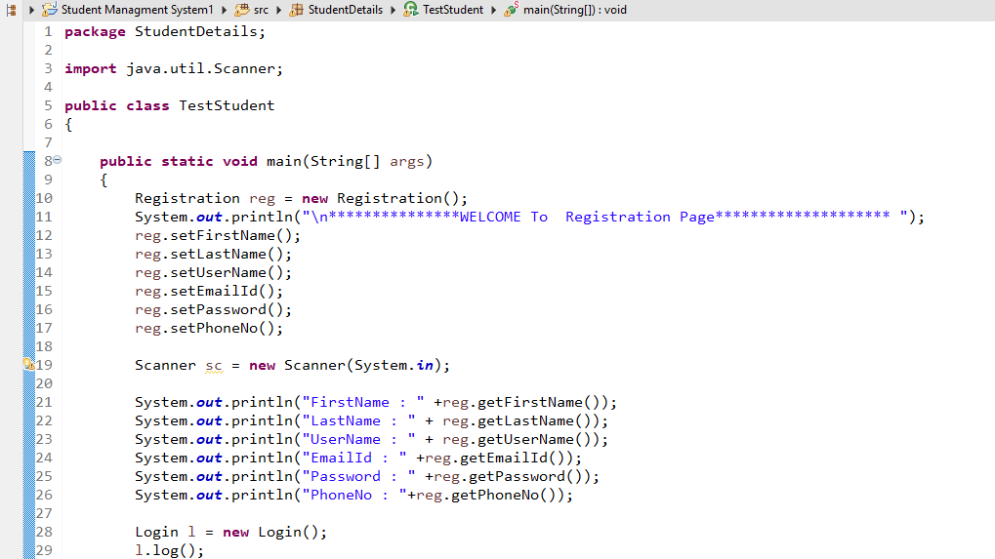

Slide 24
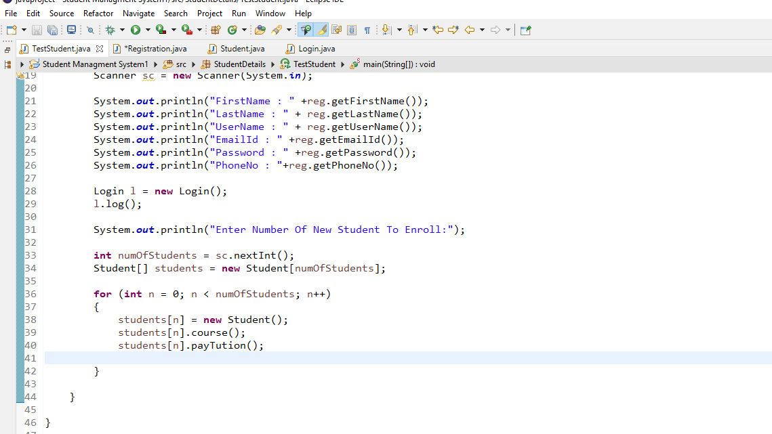

Slide 25
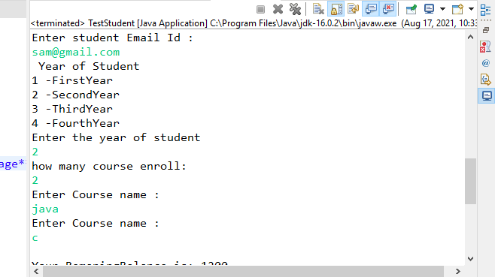

Slide 26
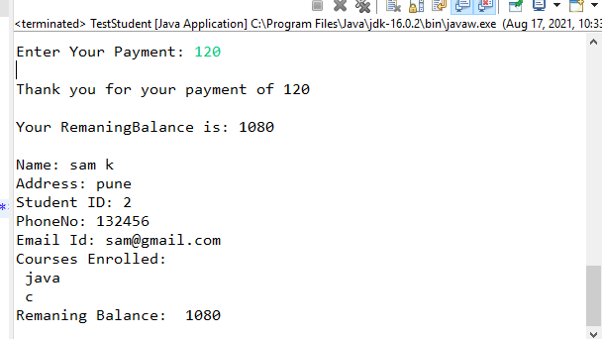

Slide 27
Advantages
1. Eco-Friendly: paperwork can be avoided.
2. Efficient control over student data.
3. Single solution for total College management.
4. Cost-efﬁcient and User-friendly.
5. Easy access to manage student information.

Slide 28
Conclusion
Student Management System can be used by educational institutions to maintain their student records easily.
Achieving this objective is difficult using the manual system as the information is scattered, can be redundant, and collecting relevant information very time-consuming. All these problems are solved by this project.

Slide 29
Thank You!

